Slide 1
Preliminaries for ASC Algorithm for MST
Next, a “data structure” level presentation of Prim’s algorithm for the MST is given.
The data structure used is illustrated in the next two slides.
  This example is from the Nov. 1994 IEEE Computer paper cited in the references.
There are two types of variables for the ASC model, namely
  the parallel variables (i.e., ones for the PEs)
  the scalar variables (ie., the ones used by the control unit).
  Scalar variables are essentially global variables.
    Can replace each with a parallel variable.
In order to distinguish between them here, the parallel variables names end with a “$” symbol.
Each step in this algorithm is constant.
One MST edge is selected during each pass through the loop in this algorithm.
Since a spanning tree has n-1 edges, the running time of this algorithm is O(n) and its cost is O(n ²).
Since the sequential running time of the Prim MST algorithm is O(n ²) and is time optimal, this parallel implementation is cost optimal.

Slide 2
a
2
2
8
b
7
c
4
3
9
6
d
3
e
f
Figure 6 in [Potter, Baker, et. al.]

Slide 3
candidate$
current_best$
mask$
node$
a$
b$
d$
e$
parent$
PEs
c$
f$
a
∞
2
8
∞
∞
∞
no
b
2
∞
7
4
3
∞
no
a
2
IS
c
8
7
∞
∞
6
9
yes
b
7
sequential
program
control
d
∞
4
∞
∞
3
∞
yes
b
4
root
a
e
∞
3
6
3
∞
∞
yes
b
3
next-
node
b
f
∞
∞
9
∞
∞
∞
wait

Slide 4
Algorithm: ASC-MST-PRIM(root)
Initialize candidates to “waiting”
If there are any finite values in root’s field,
set candidate$ to “yes”
set parent$ to root
set current_best$ to the values in root’s field
set root’s candidate field to “no”
Loop while some candidate$ contain “yes”
for them
restrict mask$ to mindex(current_best$)
set next_node to a node identified in the preceding step
set its candidate to ‘no”
if the values in next_node’s field are less than current_best$, then
set current_best$ to value in next_node’s field
set parent$ to next_node
if candidate$ is “waiting” and the value in next_node’s field is finite
set candidate$ to “yes”
set parent$ to next_node
set current_best to the values in next_node’s field
Figure 6(c) in [10, Potter, Baker, et. al.]

Slide 5
Comments on Figure 6
The three preceding slides show figure 6 from the [Potter, Baker, et.al.] IEEE Computer, Nov 1994].
Figure 6c gives a compact, data-structures level pseudo-code description for this algorithm
  Pseudo-code illustrates Potter’s use of pronouns (e.g., them) and possessive nouns.
  The mindex function returns the index of a processor holding the minimal value.
  This MST pseudo-code is much shorter and simpler than data-structure level sequential MST pseudo-codes
    e.g., see one of Baase’s textbook cited below
    Algorithm given in Baase’s books is essentially the same as this parallel algorithm
Next, a more detailed explanation of the algorithm in Figure 6c will be given.
Reference:
Sara Baase, Computer Algorithms: Introduction to Design and Analysis, 2nd Edition, Addison Wesley Publishing Co.,1988, 162-166. (Alternately, see the 3rd edition by Baase & Van Gelder, 2000.)

Slide 6
Algorithm: ASC-MSP-PRIM
Initially assign any node to root.
All processors set
  candidate$ to “waiting”
  current-best$ to ∞
  the candidate field for the root node to “no”
All processors whose distance d from their node to root node is finite do
  Set their candidate$ field to “yes
  Set their parent$ field to root.
  Set current_best$ = d.
While the candidate field of some processor is “yes”,
  Restrict the active processors to those responding and (for these processors) do
    Compute the minimum value x of current_best$.
    Restrict the active processors to those with current_best$ = x and do
      pick an active processor, say one that contains node y.
        Set the candidate$ value of node y to “no”
      Set the scalar variable next-node to y.

Slide 7
      If the value z in the next_node column of a processor is less than its current_best$ value, then
        Set current_best$ to z.
      Set parent$ to next_node
For all processors, if candidate$ is “waiting” and the distance of its node from next_node is not ∞, then
  Set candidate$ to “yes”
  Set parent$ to next-node
  Set current_best$ to the distance of its node from next_node.

Slide 8



Quickhull Algorithm for ASC
Reference:
  [Maher, et.al, Associative Convex Hull]
Review of Sequential Quickhull Algorithm
  Suffices to find the upper convex hull of points in below diagram that are on or above line
Select point h so that the area of triangle weh is maximal.
Proceed recursively with the sets of points on or above the lines and .
_{h}
_{e}
_{w}

Slide 9
_{point$}
_{y-coord$}
_{left-point$}
_{x-coord$}
_{right-pt$}
_{name$}
_{area$}
_{hull$}
_{job$}
p₁
1
3
p1
p3
1
1
_{w}
0
p₂
7
1
p1
p3
0
IS
p₃
12
2
p1
p3
1
1
_{e}
p₄
8
4
p1
p3
1
h
p₅
11
7
p1
p3
1
ctr
p₆
8
9
p1
p3
1
1
_{h}
p₇
2
6
p1
p3
1
_{P6, h}
_{p5}
_{p7}
_{p4}
_{p1, w}
_{P3, e}
_{p2}

Slide 10
ASC Quickhull Algorithm
(Upper Convex Hull)
ASC-Quickhull( planar-point-set )
Initialize: ctr = 1, area$ = 0, hull$ = 0
Find the PE with the minimal x-coord$ and let w be its point$
  Set its hull$ value to 1
Find the PE with the PE with maximal x-coord$ and let e be its point$
  Set its hull$ to 1
All PEs set their left-pt to w and right-pt to e.
If the point$ for a PE lies above the line
  Then set its job$ value to 1
  Else set its job$ value to 0

Slide 11


ASC Quickhull (continued)
Loop while parallel job$ contains a nonzero value
  The IS makes its active cell those with a maximal job$ value.
  Each active PE stores in area$ the area of triangle( left-pt$, right-pt$, point$ )
  Find the PE with the maximal area$ and let h be its point.
    Set its hull$ value to 1
  Each active PE whose point$ is above
    sets its job$ value to ++ctr
  Each active PE whose point$ is above
    sets its job$ to ++ctr
  Each active PE with job$ < ctr -2 sets its job$ value to 0

Slide 12
Performance of ASC-Quickhull
₅
₃
₄
₁
₆
₂
₀
•
Average Case:
Assume
  Roughly 1/3 of the points above each line being processed are eliminated.
  O(lg n) points are on the convex hull.
Then the average running time is O(lg n)
The average cost is O(n lg n)
Worst Case:
Running time is O(n).
Cost is O(n²)

Slide 13
MASC Quickhull Algorithm
(Upper Convex Hull)
Algorithm:
Use IS₁ to execute the first loop of ASC-Quickhull
Idle ISs request problems from busy ISs who have inactive jobs on their job$ list.
Control of the PEs for an inactive job are transferred to the idle IS. The control of these PEs is returned to original IS after the job is finished.
₂
₂
₁
₁
₂
₂
₀
•

Slide 14
Analysis for MASC Quicksort
Average Case:
Assumptions:
  roughly 1/3 of the points above each line being processed are eliminated.
  O(lg n) Instruction Streams are available.
  There are O(lg n) convex hull points
The average running time is O(lg lg n)
Essentially constant time for real world problems.
Worst Case
O(n)
Note: Taken from a latex presentation prepared by Atwah called “An Associative Model of Computation” in directory ~jbaker/slides/matwah.

Slide 15
MASC SIMULATION
RESULTS
Remaining slides in this chapter were covered very quickly and lightly in F04
They were not tested.
Expect this material to be covered primarily in parallel algorithms course

Slide 16
Previous MASC Simulation
(See Preceding Slide)
MASC Simulation of PRAM
  MASC(n,j) can simulate priority CRCW PRAM(n,m) in O(min{n/j, m/j}) with high probability.
  MASC(n,1) [or ASC] can simulate priority CRCW with a constant number of global memory locations in constant time
    This result is stronger than it first appears
    Some CRCW algorithms only require a constant nr of global memory locations
  A reverse simulation of MASC by Combining CRCW PRAM result will be in the dissertation of Mingxian Jin
Self-simulation of MASC
  Provides an efficient algorithm for MASC to efficiently simulate a larger MASC - with more PEs and/or ISs.
  Establishes that MASC is highly scalable
  MASC(n,j) can simulate MASC(N,J) in O(N/n + J) extra time and O(N/n + J) extra memory.

Slide 17


Simulation Preliminaries
Reasons to simulate other models using MASC
  Allows a better understanding of the power of MASC
  Provides a simulation algorithm that can be used to convert algorithms designed for the other model to MASC
Basic Assumption Used in the Simulations
  MASC(n, ) has a mesh PE network with row-major ordering
  The enhanced meshes have a 2D mesh with the same size and ordering
  Each PE in MASC has the same computational power as an enhanced mesh PE
  The MASC buses and the buses of the enhanced mesh have the same characteristics
  The word lengths of both models are the same and at least ⎡lg(n)⎤.
  Each PE in MASC knows its position in the 2D mesh.
    Words can store the positions of various PEs

Slide 18
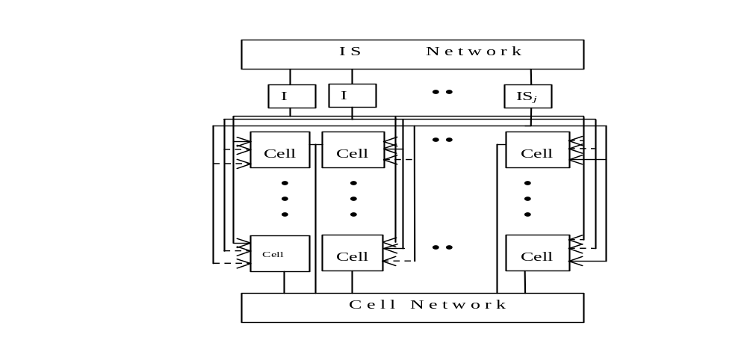
Simulation Mappings between MASC & the Enhanced Mesh MMB
The mapping is between MASC(n, ) and Enhanced meshes of size
The mapping assigns a PE in one model to the PE that is in the same position in the 2D mesh in the other model
The ith IS in MASC simulates both the ith row and the ith column buses

Slide 19
Simulation of MMB with MASC
Since both models have identical 2D meshes, these do not need to be simulated
Since the power of PEs in respective models are identical, their local computations are not simulated
To simulate a MMB row broadcast on the MASC,
  All PEs switch to their assigned row IS
  The IS for each row checks to see if there is a PE that wishes to broadcast
  If true, the IS broadcasts this value to all of its PEs (i.e., the ones on its assigned row).
Simulation of a MMB column broadcast is similar
The running time is O(1)
There are examples that show the MASC model is strictly more powerful than the MMB model
Theorem 1.
MASC(n, j) with a 2-D mesh is strictly more powerful than a MMB for j = Ω( ).
An algorithm for a MMB can be executed on MASC(n, j) with j=Ω( ) and a 2-D mesh with a running time at least fast as the MMB time.

Slide 20



Simulation of MASC by MMB
PE(1,1) stores a copy of the program and simulates the ISs sequentially.
Each instruction stream command or datum is first sent by P(1,1) to the PEs in the first column.
Next, the PEs in the first column broadcast this command or datum along the rows to all PEs.
Each MMB processor uses two registers, channel and status, to decide whether or not to execute the current instruction.
  channel records which IS the processor is assigned to
  status records whether PE is active, inactive, idle
The simulation of simultaneous broadcasts of ISs takes O( ) time.
A local computation, memory access, or a data movement along local links are identical in the two models and require O(1) time.
The execution of a global reduction operator OR, AND, MAX, MIN takes O( ) using an optimal MMB algorithm (details omitted).
Since the global reduction operators may be computed for O( ) ISs, an upper bound is O( ) or O( ).
Theorem 3.
MASC(n, ) with a 2-D mesh can be simulated by a MMB in O( ) time with O( ) extra memory

Slide 21
Simulation Conclusions
MASC is strictly more powerful than an MMB of the same size.
Any algorithm for an MMB can be executed on a MASC of the same size with the same running time. In particular,
  Optimal algorithms for MMB are also optimal when executed on MASC
CLAIM: MASC and RM are very dissimilar and can not simulate each other efficiently.
  Details in Jin’s dissertation.

Slide 22
Suggested Changes
Probably move simulation material to the parallel algorithms course.

